Slide 1
End-of-Life Care
Reconcilable Differences
Name of presenter
position
Notes:
The presenter should include your name here. Start by saying a few words about yourself.
This presentation was originally develop by Michael GuntherMaher MD, FACP
Palliative Care and Hospice
Kaiser-Permanente, Sacramento

Slide 2
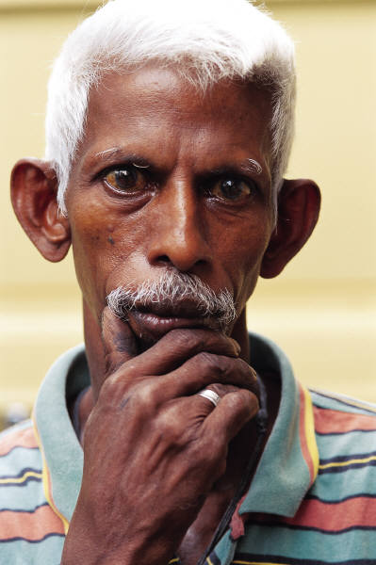
Objectives
Review the current state of dying in America
Frame opportunities for the Faith Community to address:
The circumstances in which people die, and
Their burden of suffering in the process.

Slide 3
How Americans died in the past . . .
Early 1900s
  Average life expectancy was 50 years
  Childhood mortality high
  Adults lived into their 60s
  Most everyone had witnessed someone dying
Notes:
Quick review, little need to elaborate.

Slide 4
. . . How Americans died in the past
Prior to antibiotics, people died quickly
  Infectious disease
  Accidents
Medicine focused on caring & comfort
Sick cared for at home
  Hospitals seen as places to die
Notes:
Quick review, little need to elaborate.

Slide 5
Medicine’s and society’s shift in focus . . .
Science, technology, communication
Marked shift in values & focus of society
  “death denying”
  value productivity, youth, independence
  devalue age, family, interdependent caring
Few people today have personally witnessed someone dying
Notes:
Quick review, little need to elaborate.

Slide 6
Societal shift in focus . . .
Improved sanitation, public health, antibiotics, other new therapies
  Increasing life expectancy
  2011 average: 79 years
Potential of medical therapies to
  “fight aggressively” against disease
  prolong life at significant cost
Death may be an option….
Notes:
Quick review, little need to elaborate.

Slide 7
Death, once a publicly witnessed event,
that commanded respect;
today all too frequently is a protracted,
expensive hidden process with
overtones of failure.
Lewis Thomas
Notes:
Lewis Thomas was an American physician, poet, etymologist, essayist, administrator, educator, policy advisor, and researcher, who died in 1993.

Slide 8
“A detailed national survey…from 2003 claimed that fully 92% of Americans believe in God, 85% believe in heaven, and 82% believe in miracles. But the deeper truth is that such religious belief, complete with a heavenly afterlife, brings believers little solace in the face of death. The only priesthood in which people really believe is the medical profession and the purpose of their sacramental drugs and technology is to support longevity, the sole unquestioned good of contemporary Western life.”
Simon Critchley PhD, The New School of Social Research
Notes:
Read.
Simon Cirtchley is a scholar who has studied extensively the social aspects of religion in the West.
This is clearly a controversial statement, with an important truth embedded in it—people continue to hope that medicine will save them. For many, despite their religious beliefs, it may become the only hope they can identify as they approach their end. It is as if they have become lost from themselves.
As patients face terminal illness, medicine becomes a dominant focus. Eventually it fails—”there’s nothing more we can do.” (A common, misleading but somewhat accurate line frequently heard.)

Slide 9
Common Practice Model
Curative Care: 61% of Californians
Curative Care & Hospice:
39% of Californians
Hospice Care
Bereavement Care
Advanced Illness
Terminal
Illness
Death
Developed by California HealthCare Foundation. Source of data: 2010 Medicare Fee For Service Claims Data.
Notes:
Common Practice Model.
In previous decades the focus of medical care has been cure and survival. Sometime with little thought to the cost to the patient, family and society.
Often (and still today) people receive aggressive care in late stages of life. Care still aimed at cure and ultimate longevity even when there is little hope for avoiding anticipated outcomes. Quality of life was not considered a top priority.
With advent of patient focus and community concern over wellness and day to day quality of life, our idea of how medical care should be administered has changed.
Palliative care was born out of a patient and community driven effort to achieve better quality of life while living with and dying from cancer. It has grown into a broad medical specialty concerned with patient quality of life.

Slide 10
Sudden death, unexpected cause
Cardiac arrest, accident, etc.
<10%
Health Status
Death
Time
Notes:
Most of us hope we’ll live a long life, without much pain or loss of function, and then die suddenly in our sleep before we can experience serious illness or disability. Unfortunately, only about 10% of us will die this way. The y axis shows health status or well-being, and x axis shows time. Common causes are accidents and sudden death from cardiac arrest.
The rest of us will die with some kind of chronic illness.

Slide 11
Protracted life-limiting illness
Most people (> 90%) face a chronic illness:
  Predictable steady decline with a relatively short “terminal” phase – most cancers
  Slow decline punctuated by periodic crises – such as congestive heart failure, emphysema
  Prolonged decline with gradual loss of function and risk for illness – such as Alzheimer’s disease
Notes:
There are 3 patterns that describe how most of us will die.
Some will develop cancer or a similarly terminal illness, that cannot be cured. The decline will occur over months to a year or two, then we’ll die.
Many of us will have chronic organ failure like heart failure or lung disease. We’ll have episodes where we get acutely ill and end up in the hospital, then get better. However, slowly over time we’ll see our vitality draining away.
Unfortunately, about 15% of us will develop dementia or some other neurologic disease that slowly takes away our abilities and identity over a period of 7-15 years. Even a few years before our death we’ll be hopelessly disabled.
The following slide shows these patterns in graph form.

Slide 12
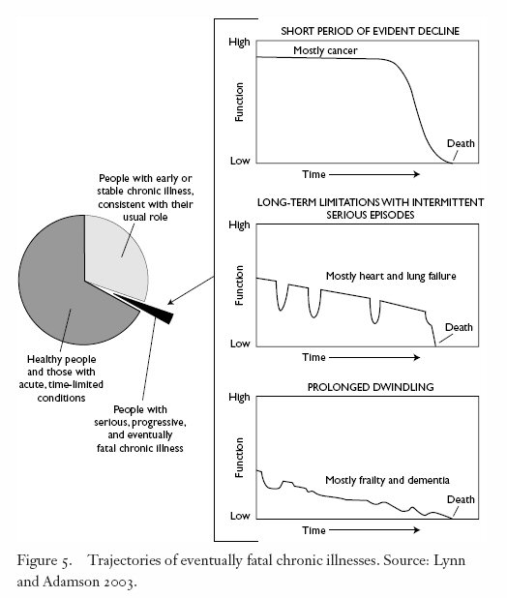
Trajectories of eventually fatal chronic illnesses. Source: Lynn & Adamson, 2003
Notes:
12
This is an illustration of three common trajectory curves.
You might spend a few minutes going over these graphs, as this is a major part of the argument for getting our colleagues to participate more in EoL care.

Slide 13

In a word, it’s gonna be difficult.
Notes:
It can feel like a person’s world is coming apart.

Slide 14
Symptoms & Suffering
Multiple and diverse fears, fantasies, worries
Multiple physical symptoms
  Inpatients with cancer average 13 different symptoms, outpatients average 9
Psychological distress
  Anxiety, depression, fear, sadness, hopelessness,
  40% worry about “being a burden”
Notes:
Dying patients often have a variety of challenges, discomforts and distresses that combine to create their experience of suffering. The multiplicity of issues is often underappreciated by those around them, including health care professionals.

Slide 15
Caregiving
90% believe it is a family’s responsibility
Frequently falls to a few people
  Often women
  Care needs often exceed family’s ability to meet them
Guilt from “failure” to provide home care
Financial pressures
  Lost income or impoverishment in 40% of families
Notes:
The great majority of families find themselves unprepared to deal with the decline and demise of their loved ones. Today many families are separated by great distances and by jobs. It becomes a major life event for someone to drop what they’re doing to care for a dying family member. Jobs are often put on hold or even lost. The money runs out. Many patients and families face impoverishment as a result.

Slide 16
Place of Death
70% of Californians want to die at home
Where deaths occur
  32% at home
  42% in a hospital
  18% in a nursing home
Who leaves a nursing home?
  10% die in 4 weeks
  25% live an average of 2 years in the SNF, then die
  25% return to the hospital
Notes:
Most people say they want to die in their own home—whether that be a house, apartment, Board & Care or the home of a family member. But the sad truth is that many do not.
Many dying patients need more care than can be provided by family, and so end up in B & Cs with Hospice participating. Patients who are highly symptomatic or who have complex medical needs may go to a nursing home or skilled nursing facility, typically under the Medicare Skilled Benefit and without concomitant Hospice support.
SNFs carry a tarnished reputation in many communities. There are complex reasons for this, but one of them certainly is the fact that the types of patients who require SNF care are sick, disabled and often close to the end of life. Even though SNFs in many areas are used for rehabilitation following an acute hospitalization, many do not return home, as the data shows here (data collected from the Elder Care Program at Kaiser Permanente, Sacramento, from 2000-2008; source Michael GuntherMaher MD, unpublished).

Slide 17
Dying in America: Summary
Today patients, families and healthcare providers are participating in a culture designed to give most patients an end-of-life experience that does not fit with their values, priorities and hopes.
Notes:
Read.

Slide 18
Why are things this way?
Patients and professionals each are waiting for the other to raise a difficult subject
Patients / families
  don’t know their predicament, or…
  don’t want to know their predicament, or…
  don’t know and understand their options, or…
  can’t get the help they need to approach things differently, or…
  some combination of the above.
Notes:
Everyone knows the two things in life that are certain: death and taxes. Yet most Americans are prepared to deal with only one of these.
Trying to make sense of so complicated an issue is difficult work. Nevertheless, much of the problem has to do with communication. There is a culture of “don’t ask, don’t tell” when it comes to difficult issues. Even when the subjects are broached the language is ineffective. Physicians may use clinical terms that are hard for normal people to understand. Patients and families may be unable to hear much that follows the initial bad news. Medical care professionals may not spend the time to assess the various needs of the patient, or may not know how to meet them—and the families may find themselves in the same predicament.

Slide 19
Better Practice
Concurrent Care across Settings of Care
Curative Care
focus of care
Hospice Care
Palliative Care
Bereavement Care
Advanced Illness
Terminal
Illness
Death
Developed by California HealthCare Foundation
Notes:
This model demonstrates a more realistic view of how care should be delivered in the later stages of disease or the last phase of life. Gradually symptom management and quality of life trump over aims to cure or prolong life at all cost. Patients and families receive intensive comfort, planning and support during the same time they are getting standard curative treatment. Hopefully, by the time they curative treatment is no longer helping, the transition to comfort-focused care and hospice will feel seamless and natural.
In the last phase, hospice care is provided as death approaches.

Slide 20
Conversations that address the real issues in dying
“This is your current predicament.”
“What is important to you now ?”
“What does this mean for you? How is this affecting your sense of self?”
“This is how we can help you.”
Notes:
How will we get to a model like this? How will terminally ill patients have a future that is different from what most are currently experiencing? What will make your dying experience more like the ideal?
Communication is a big part of the solution, and something that all caring professionals—and non-professionals—can participate in.
These are the key topics:
Helping patients and families understand what is happening and what is at risk,
Finding out what their goals are in light of their predicament,
Exploring the spiritual experience that is always a major part of dying, and
Offering competent help for the issues at hand.

Slide 21
Conversations that address the real issues in dying
Any willing and capable person can initiate and participate in these conversations.
Unfortunately, they are often left for busy healthcare professionals to initiate.
Notes:
This is another statement of why we are doing this course. Just as the medical community will never solve world hunger, so the medical community will never be adequate to address the breadth and depth of issues that dying patients face. Leaving it all up to them is a losing strategy, even if there are Palliative Care doctors and Hospice nurses aplenty. The truth is that there will not be enough of them for the foreseeable future.

Slide 22
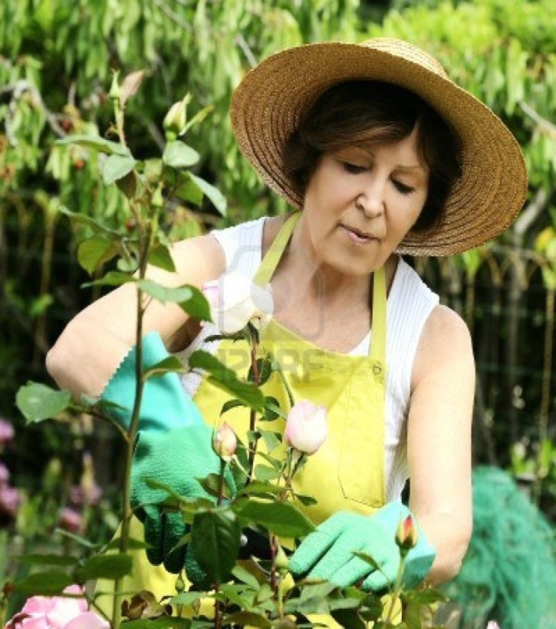
Why talk about “goals”?
Every one has a personal sense of
  who we are
  what we like to do
  control we like to have
  things we hope for
Hope, goals, expectations change with illness and with time
Notes:
This is the crucial issue for terminally ill patients. In actuality they are still quite alive—they are living!—and the issues they face are about living to the fullest while experiencing the failure of their health. Who are they, what do they hope for, what is important to them, what would be intolerable to them?

Slide 23
Historical tension between goals of medical care
Focus on curing illness
  Typically the presumed goal
  Based on a “medical” view of health and illness
Little attention to relief of suffering or the provision of dignity
  Saving a life supersedes other potential outcomes
  Hospice / palliative care arose in response to this need; focuses on “the whole person”
Notes:
The medical profession are long presumed the goal of behind their involvement to be to cure the patient. This is a good goal much of the time—you wouldn’t want a surgeon with any other goal operating on you, would you?
But this is not a reasonable goal when patients are terminally ill. There are costs to many medical interventions—not just financial, but side effects, adverse risks, days spent away from home, etc.
For much of the last 70 years the focus on cure has overshadowed any attention to pain and suffering. The hospice movement of the 70’s arose in part due to this. Even with the establishment of the Medicare Hospice Benefit in 1983, many terminally ill patients have continued to experience great suffering. The Palliative Care movement that began in the last 90’s is a response to this.

Slide 24
Ms. B. . .
52 year old woman with stage 4 gastric cancer
Has large tumors in her stomach and lower abdomen; requires a tube to decompress her stomach, which cannot empty what she eats
Dependent on intravenous feeding
Lives in chronic pain, on high doses of opioids
Notes:
This is a case from MGM’s experience. Feel free to use another case that illustrates the complex issues around goals of care.

Slide 25
. . . Ms. B
Ms. B has been hospitalized 4 times in 6 months with pain and nausea
She is NOT willing to discuss hospice or dying
She wants more chemotherapy
Notes:
One of the things that is fairly common among terminally ill patients is the desire for more curative treatment even when it is more likely to harm than help. Identifying goals other than cure can be a challenge in these situations.

Slide 26

Outcomes of value to patients and families at the end of life
Physical comfort
Relief of suffering
Completion of a project
Experience of intimacy
Return to home
Reconciliation
Minimized burden to family
Notes:
Patients who are free to talk about what is important to them will identify a variety of things. This is a short list.

Slide 27
Potential goals of care
Cure of disease
Maintenance or improvement in function
Prolonging life
Relief of suffering
Quality of life
Staying in control
A good death
Support for families and loved ones
Notes:
Medical professionals often reframe the patient’s goals into terms that are relevant to the medical setting.

Slide 28

Multiple goals of care
Multiple goals often apply simultaneously
Goals are often contradictory
Certain goals may take priority over others
Notes:
Just as in life, so in death, we often want things that cannot simultaneously coexist. When time and health are short, it becomes extremely important to prioritize these goals if any of them are to be obtained. Sadly, many patients and families continue to defer such a resolution—which usually requires giving up something and accepting something else—and struggle unhappily until the end.

Slide 29
Goals may change over time
Priorities may change
  deterioration of health
  accomplishment of key life tasks
  altered quality of life
Goals should determine the care plan
The shift in focus of care
  should pace the changes in the patient’s life
  gives rise to the continuum of medical care
Notes:
We all know from our own lives that our priorities in life may change. For terminally ill patients, goals may change from month to month or day to day depending on the tempo of illness and the ability to accomplish important tasks.
All medical care plans are happening in real time, and need to change in real time in response to the patient’s status. That necessarily means that the care plan must respond to the patient’s goals.
This may seem obvious to those of us in the room right now, but it is often far from obvious to patients who are overwhelmed by disappoint, fear, conflict and the pressure to make a decision. It often takes someone else saying to them “I don’t think you can return to your apartment in this condition” for them to realize that it’s true. Likewise, when patient’s say “I want to go home now” it is important to clarify if they mean to stop efforts to prolong life. If that’s true, medical professionals need to stop antibiotics and IV fluids and whatever else and focus on getting the patient home safely.

Slide 30
Barriers to addressing goals at the end of life
Fear of pain or abandonment
Misperception of “doing nothing”
Cultural and personal values around pain, suffering and prolongation of life
Limited knowledge of the dying process
Guilt or discomfort on the part of decision-makers
Medical model that promotes interventions
Notes:
This is a short list of the many reasons that patients don’t have a full discussion about their goals.
Abandonment is a two-sided issue. Patients may fear loss of access to physicians or hospitals. Physicians and nurses may fear loss of relationship or breach of duty to their patient.
Some professionals still see their role as solely that of cure, so that abandoning the treatment plan is equivalent to “doing nothing”. Some families and patients also talk this way.
People are a product of their cultures and personal histories, and have systems of meaning by which they understand and experience their lives. For many, pain and suffering may be part of a story or belief that is important to them, even if they don’t like the story or belief.
Many fear the dying process because of the unknowns.
Family who speak on behalf of an incapacitated loved one may feel a measure of responsibility or guilt, should their words appear to foster a plan to abandon curative efforts. “Playing God” is a term that one often hears.

Slide 31
Script for discussing goals
Make sure that patient & family are appropriately informed of the facts
Elicit their concerns & questions
Ask: “What is important to you at this point?”
Clarify: “Based on what we’ve discussed, it seems that your goals are ____.”
Explore potential conflicts or contradictions.
Notes:
This is a suggested outline for discussing the goals of care with a patient or family member. You’ll notice themes from an earlier slide.
Always start with “where we are”, ie the facts. Make sure they know what they need to know and have their questions about this addressed first. (Faith Community leaders may help a patient of family formulate the questions they want or need to ask medical staff)
Be curious about concerns and fears. Explore. This will allow them to answer the pivotal issue, “what is important now?”
Summarize and say it back to them. If they nod their head, you’ve got it and can now make some recommendations.
Don’t want for conflicts or contradictions to find you. If you can see that the expressed goals are not compatible, this is the time to say that. If the patient or family cannot “get real” about the incompatibility, you may want to explore the issues behind that.

Slide 32
Goals of Care: A Summary
The typical end-of-life scenario is medically, psychologically, socially and spiritually complex.
Any medical care plan always presumes a goal.
  Care plans at end of life are sometimes confused, misdirected or simply ineffective.
Goals need clarification in complex situations.
  Best done by those who can bring compassion, perspective and calm to an often overwhelming topic.
Notes:
Read.

Slide 33
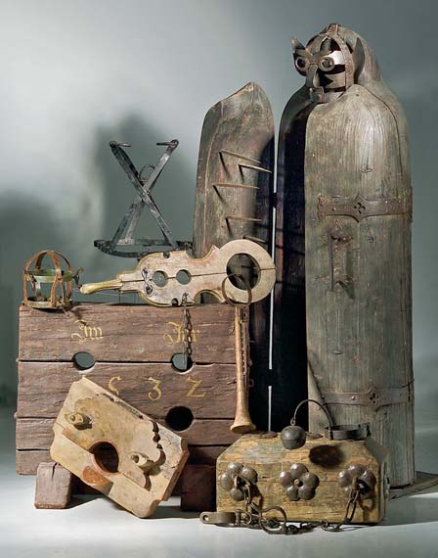
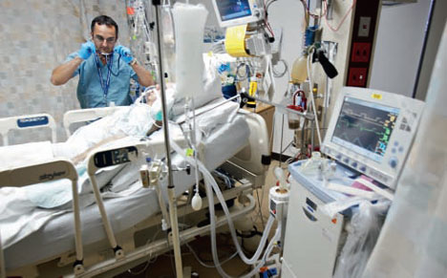

Pain and Suffering
Notes:
The picture on the left is a collection of torture devices used during the Spanish Inquisition. To the upper right we have what some patients (not most, thankfully) consider the modern equivalent—the ICU. And the well known bottle of pills.
We want to spend a few minutes providing an overview about pain and suffering among dying patients.

Slide 34
Managing pain
Two common problems U.S.
  Under-treatment of pain in dying patients
  Inappropriate use of opioids in chronic, non-malignant pain
For 90% of dying patients – pain can be well controlled
For 10% of patients – pain control with significant side effects
Effective pain management may shorten life in some cases
Notes:
Read.

Slide 35
Why dying people have pain
Disease process can be painful
Treatment and tests can cause pain
Another medical condition
Ineffective medical management
Patient-specific issues
  Spiritual pain
  Psychiatric or social problems
  Hidden agendas
Notes:
Read.

Slide 36
Barriers to pain control
Pain is subjective, difficult to assess objectively
Patients learn to adapt to pain
  Hide, divert attention
Pain may be about other concerns
  “I am a ‘wimp.’ I should ‘tough it out.’”
  “My disease is getting worse.”
Doctors may underestimate pain
Nurses may undertreat pain
Notes:
Read.
That doctors may underestimate pain is not surprising. Patients can experience significant pain and still appear calm. Doctors may fear the risk of abuse of medications, or side effects that may hamper rehabilitation.
Nurses may undertreat pain because they may be too busy to reassess the patient, or may need to call a doctor to get a new order if the medication is not working well enough, or may trust the doctors order more than the patient’s report.

Slide 37
Cultural factors in addressing pain
It’s difficult to be with a person in pain
It’s difficult to communicate about pain
  Physical pain
    Different language for describing and rating
    Interpretations of what pain means
  Spiritual pain
    Agreement on what this is
    Language to use
Accepting treatment may seem to threaten autonomy
Notes:
All of us, whether health care professionals or not, have challenges in understanding someone else’s pain. This is a short list.
It is often uncomfortable just being with someone in pain, especially if you’re empathetic. We all tend to avoid putting ourselves in that situation too often.
It can be difficult for patients to describe their pain. We use a 10-point scale in the hospital and in Hospice, which is simple enough, and still sometimes difficult for patients to use.
Spiritual pain is a difficult issue, yet clearly real to most of us who care for the dying. Unresolved issues of meaning, disappointment, dismay, fear and abandonment may amplify the distress prompted by a physical sensation. It can be difficult to talk about this, which is one reason why the role of chaplains and spiritual care professionals is so important.
Finally, patients may fear loss of some of their autonomy just by “giving in” to pain medication.

Slide 38
Pain vs Suffering
Pain – a physical sensation
  Some talk of pain as distress that is not limited to merely the physical domain
Suffering – an ongoing experience of distress with multiple causes and manifestations
  Physical (pain and other symptoms)
  Non-physical (emotional, mental, spiritual, relational)
Notes:
Read.

Slide 39
Pain is but one aspect of suffering
SUFFERING
PAIN
fear
air hunger
anxiety
Physical
Emotional
depression
nausea
Spiritual
anger
weakness
Notes:
There are a variety of symptoms that patients may experience as they die, and a variety of emotions, some of which are listed here. All of these are part of the larger issue of suffering, which has physical, emotional and spiritual domains.

Slide 40
Suffering is affected by many life domains
Past experience
Finances
SUFFERING
Life events
Family concerns
Losses - dignity, independence
Notes:
Suffering is informed by the patient’s story, their social and family context, and the physical and social losses they experience as their health declines.

Slide 41
Myths about pain treatment
Save the “good stuff” for “the end.”
Take medication only when in severe pain.
Cancer patients always have uncontrollable pain.
Never give opioids to patients with heart or respiratory failure.
Opioids make you deteriorate faster.
Taking opioids will make you an addict.
Notes:
These are the common myths about pain medication.
Some believe that, if you want the good stuff to work when you need it, you should defer using it until things get bad. Or that you should treat only severe pain.
Although many cancer patients have significant pain, some believe that cancer always causes distressing pain that leads to a miserable death.
Some fear that opioids will cause accelerated heart or lung failure. Or that they make you die sooner.
A common belief is that opioids lead to addiction.
None of these are true, though, like most myths, there is a grain of truth behind them.

Slide 42
Myth-busting opioid therapy
Don’t defer effective pain treatment
  Treat pain early
  Unmanaged pain → nervous system changes and can result in permanent damage, amplified pain
Early treatment is associated with less drug use
Addiction is very rare in dying patients
Overdose is rare
Notes:
Studies have shown that patients who treat their pain earlier and consistently will use less drug than those who wait for a crisis and then try to “catch up”. Consistently uncontrolled pain may lead to changes in the nervous system that actually promote pain.

Slide 43
Double effect
Provision of adequate symptom relief that unintentionally hastens death
Primary outcome (relief of suffering) vs. potential, secondary effect (earlier death)
The intention is to relieve pain and suffering
Ethically and legally defined and accepted
Notes:
Some patient may suffer sedation in addition to pain relief. In extreme cases, patients may require so much medication to control pain that their respiratory rate becomes depressed. As long as the intention is to treat discomfort, this is viewed as an ethically acceptable consequence.

Slide 44
Tolerance and dependence
Tolerance: With time, an increased dose is needed to experience the same effect
  This is complicated in cancer patients as the need for medication also increases as the disease progresses
Dependence: The appearance of withdrawal symptoms when the drug is discontinued
  Agitation, cramps, insomnia
Notes:
Any patient who uses any dose of opioid for greater than a few weeks will start to notice tolerance. This is normal and expected.
Dependence is common and real, but rarely seen, as symptoms only arise when the drug is stopped—and dying patients who need opioids for pain will rarely quit taking them unless deprived. Dependence is the physiologic fact that makes it difficult drug-dependent patients to wean off of medication. This is almost never an issue for the terminally ill.

Slide 45
Addiction
A psychological disorder, not a physical one
Associated with maladaptive behaviors:
  Obsession with obtaining the drug
  Personal and/or legal problems
  No improvement in quality of life with drug
Extremely rare among dying patients
Notes:
Addiction is a psychiatric disorder, with behaviors that are antisocial and obsessive. This is almost never seen in dying patients.

Slide 46
Role of faith leaders in addressing goals & pain
People listen to you differently than physicians
  It is safe to share with you
  You bring a broad and deep perspective
  Different time constraints
Provide another “rational” voice in difficult times
Suggestions
  Show up—don’t always wait to be invited
  Educate patients, families, & physicians
  Participate in care plan meetings and discussions
Notes:
The ultimate goal of this talk has been to give you some sense of what the terminally ill and dying members of your community are dealing with. We have also sought to equip you with some basic knowledge about pain and suffering so you feel better prepared to understand and perhaps advise or advocate for those you serve. Most importantly, we’ve done this to frame the centrality of the person’s values, hopes and intentions when deciding how best to care for him. We need to know who a person is, what he is experiencing, and what he hopes to get out of a difficult and sometimes urgent circumstance if we are to provide anything meaningful.
This is where you come in. You have a different role, a different perspective, and different opportunities compared to healthcare professionals.
Lost people don’t always know what they need. Therefore, the most important thing you can do is to show up in their lives. They may not know to invite you—so initiate. They may not know how you can help—so suggest and volunteer. They may not be able to sort through the issues or ask the right questions—so consider being part of the discussions, including those that happen in the hospital or clinic. Health care professionals know how difficult things can be, so they’ll be happy to see you there with the patient and family.

Slide 47
A good death
Death is the closing of a human life, not merely a medical event
Comfort and dignity can be optimized until life ends
Peace, reconciliation, fulfillment and transcendence can have ample expression for patient and family…
Notes:
Despite the prominence of medical care in terminal illness and death, the ending of life remains a constant and a major event in every human life. It has always been so, and hence it has never really been about medical care!
It helps to remember this if we are interested in helping our fellow man die in a peaceful and dignified death. Even in the face of a catastrophic illness, there remains hope.

Slide 48
A good death
Unlikely to happen without the support of an entire community (not only health professionals), and…
Unlikely to happen by accident.
Notes:
But better care, better outcomes and better experiences for dying people and their families will not happen if we defer to business as usual. I hope you are willing to find some fresh way to contribute.

